Slide 1
TRA expression in pancreatic cells
Can TRA genes be identified that are highly expressed in PDAC tissue but not in ß cells?
Can we identify the fate of pancreatic cells using TRA expression?
Can TRA genes be identified that are highly expressed in PDAC tissue but not in ß cells?
Can we identify the fate of pancreatic cells using TRA expression?
Data Analysis; Anna Boot, Carolyn Blümcke, Selina Ernst, Bianca Greul; Supervisor: Dr. Dinkelacker

Slide 2



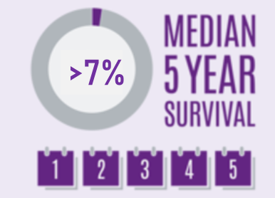
Epidemiology of pancreatic cancer
(J. He et al.,2014)
(A.Carrato et al.,2015)
(RR. L. Siegel, K. D Miller, A. Jemal ;2015)
(L. Rahib et al.,2014)
New diagnostic and treatment options needed
Data Analysis; Anna Boot, Carolyn Blümcke, Selina Ernst, Bianca Greul; Supervisor: Dr. Dinkelacker

Slide 3
Tissue restricted antigens (TRA)
Biological function
Application in cancer
Central tolerance of immune system
Negative selection of T-cells (Kyewski & Klein,2006)
Defect -> diabetes type 1 (Atkinson, Eisenbarth, Michels, 2014) 1²
Tumor marker (Hong, 2014)
Immunotherapy (Mahmoud,2018)
Targeted classic therapy (Koppe et al., 2005 ; Kahl, 2008)
Data Analysis; Anna Boot, Carolyn Blümcke, Selina Ernst, Bianca Greul; Supervisor: Dr. Dinkelacker

Slide 4
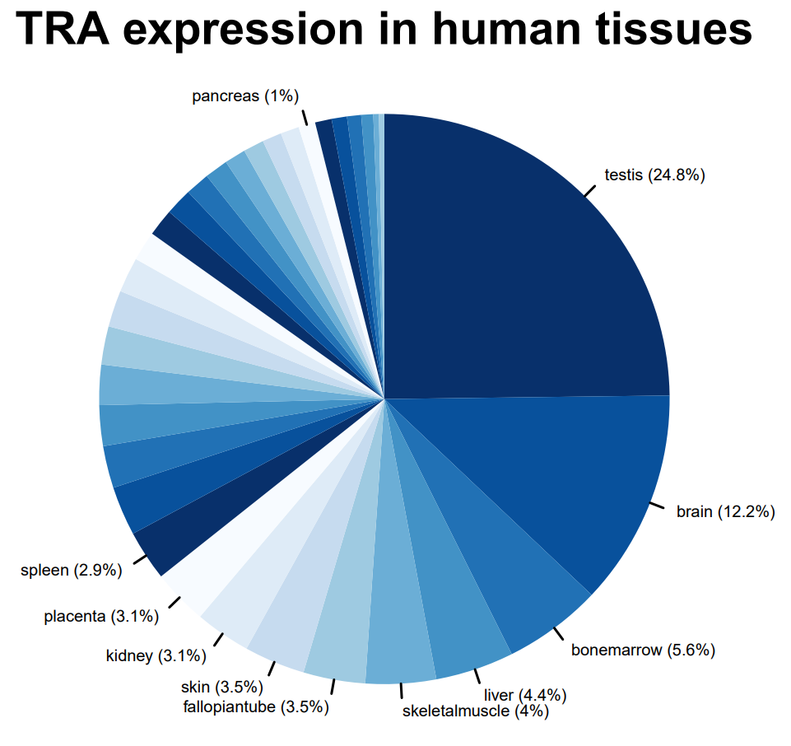
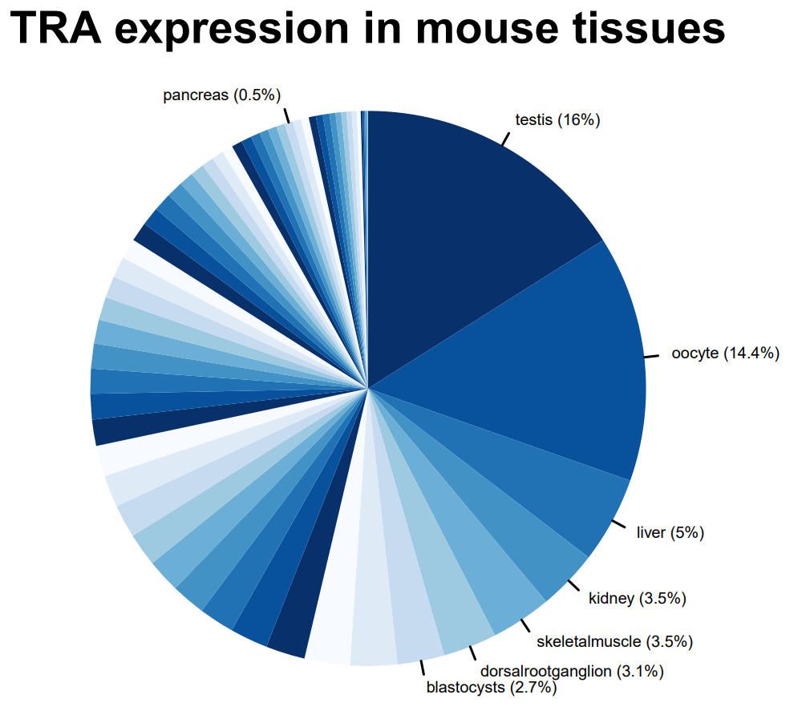
TRA data set
Pancreas specific TRAs
330 human genes
59 mouse genes
Dinkelacker, 2007
Dinkelacker, 2019
Data Analysis; Anna Boot, Carolyn Blümcke, Selina Ernst, Bianca Greul; Supervisor: Dr. Dinkelacker

Slide 5
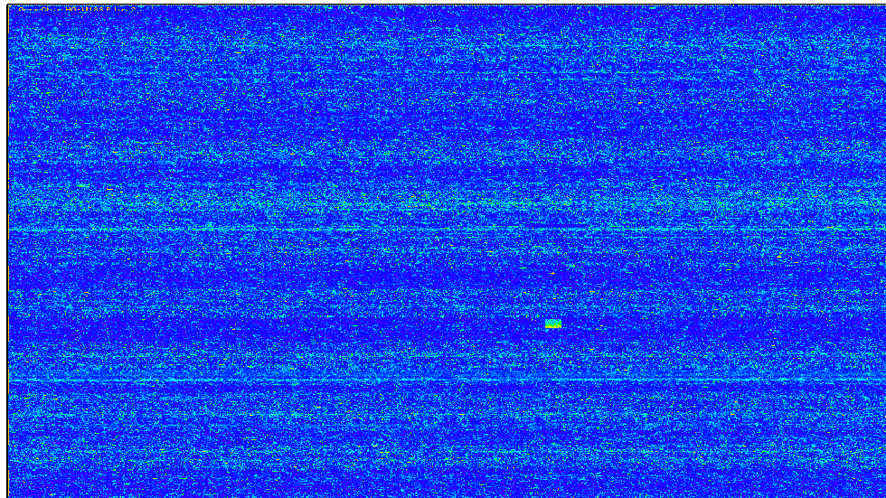
Microarray

Slide 6
Microarray data set
β-cells
PDAC cells
GSE53454; Lopes et al., 2014
GSE59761; Stoy et al., 2015
Control group
No special treatment
Different time points
Cytokine group (diabetes)
Treated with cytokines (IL-1β & IFN-γ)
Different time point
Control group
Treated with unspecified siRNA (NC)
Knockout group
Treated with siRNA against TBL1X
Data Analysis; Anna Boot, Carolyn Blümcke, Selina Ernst, Bianca Greul; Supervisor: Dr. Dinkelacker

Slide 7
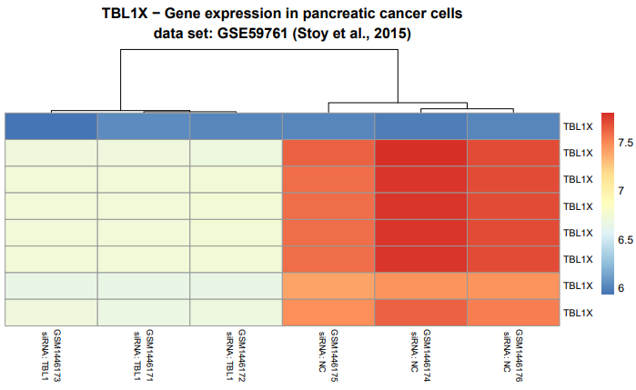
Microarray data set
β-cells
PDAC cells
GSE53454; Lopes et al., 2014
Control group
No special treatment
Different time points
Cytokine group (diabetes)
Treated with cytokines (IL-1β & IFN-γ)
Different time point
Control group
Treated with unspecified siRNA (NC)
Knockout group
Treated with siRNA against TBL1X
Data Analysis; Anna Boot, Carolyn Blümcke, Selina Ernst, Bianca Greul; Supervisor: Dr. Dinkelacker

Slide 8
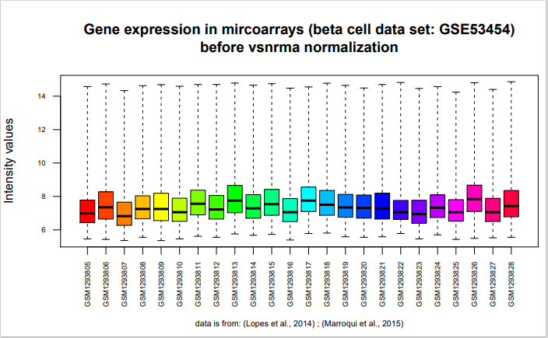
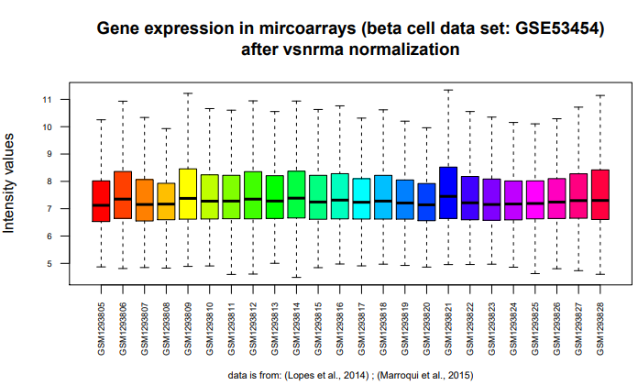
Normalization
Data Analysis; Anna Boot, Carolyn Blümcke, Selina Ernst, Bianca Greul; Supervisor: Dr. Dinkelacker

Slide 9
Milestones
TRA expression in pancreatic cells
12.05.
19.05.
26.05.
02.06.
09.06.
16.06.
23.06.
30.06.
07.07.
Project Proposal
Project finished
8 weeks
Buffer
Data Analysis; Anna Boot, Carolyn Blümcke, Selina Ernst, Bianca Greul; Supervisor: Dr. Dinkelacker

Slide 10
Milestones
12.05.
19.05.
26.05.
02.06.
09.06.
16.06.
23.06.
30.06.
07.07.
1st Milestone: Data Clean Up and Overview Data
1st Milestone: Data Clean Up and Overview Data
Correct gene symbol assignment
Descriptive statistics
2nd Milestone: Differential TRA Expression
Identify high TRA gene expression
Identify differential TRA gene expression
Compare + Literature
Data Analysis; Anna Boot, Carolyn Blümcke, Selina Ernst, Bianca Greul; Supervisor: Dr. Dinkelacker

Slide 11
TRA Data set
Highly expressed genes PDAC
Can TRA genes be identified that are highly expressed in PDAC tissue but not in ß cells?
Lowly expressed genes Diabetes
TRA Expression
Data Analysis; Anna Boot, Carolyn Blümcke, Selina Ernst, Bianca Greul; Supervisor: Dr. Dinkelacker

Slide 12
Milestones
1st Milestone: Data Clean Up and Overview Data
2nd Milestone: Differential TRA expression
12.05.
26.05.
02.06.
09.06.
23.06.
30.06.
07.07.
19.05.
16.06.
3rd Milestone: Proliferation vs. Cell death
4th Milestone: Complete project
R Markdown file
Select meaningful graphics
Answering main questions
3rd Milestone: Proliferation vs. Cell death
Changes TRAs during cytokine treatment in diabetes set
Comparison to pancreatic cancer
Linear regression model: diabetes treatment
Data Analysis; Anna Boot, Carolyn Blümcke, Selina Ernst, Bianca Greul; Supervisor: Dr. Dinkelacker

Slide 13
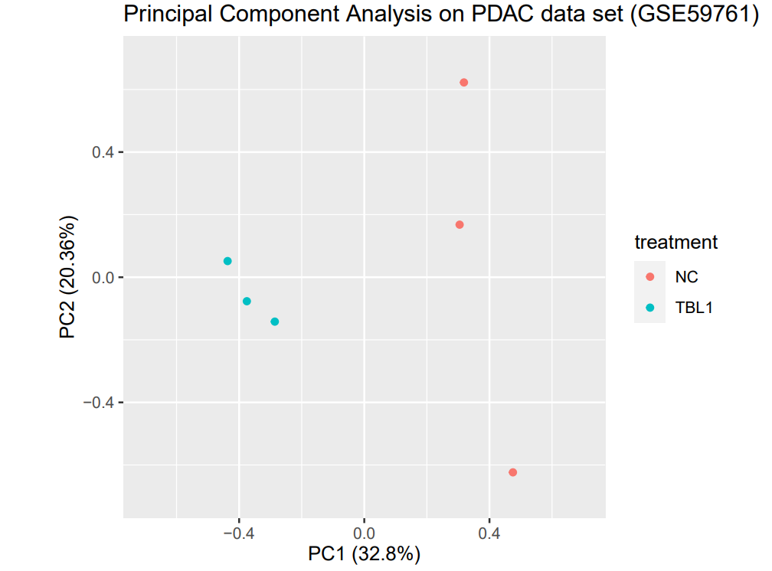
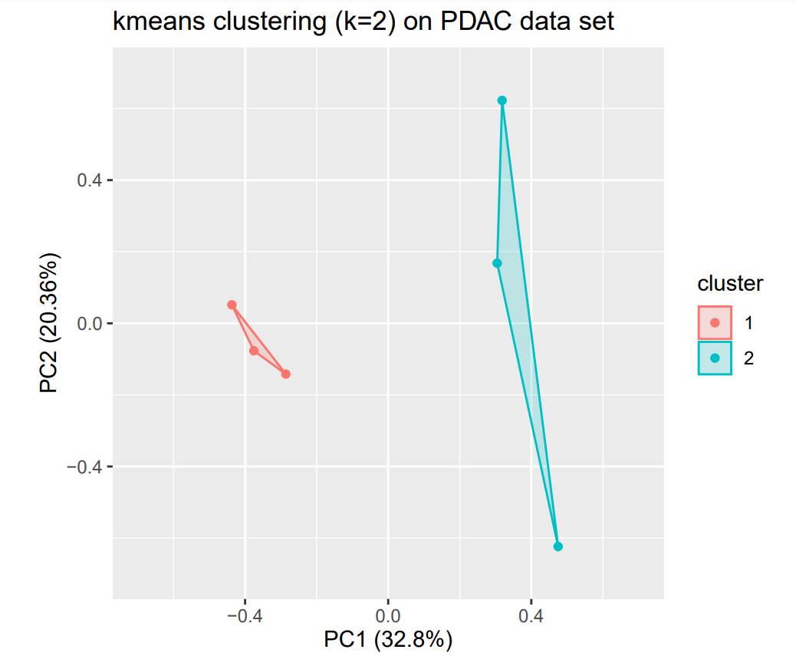
PCA + kmeans clustering
Data Analysis; Anna Boot, Carolyn Blümcke, Selina Ernst, Bianca Greul; Supervisor: Dr. Dinkelacker

Slide 14
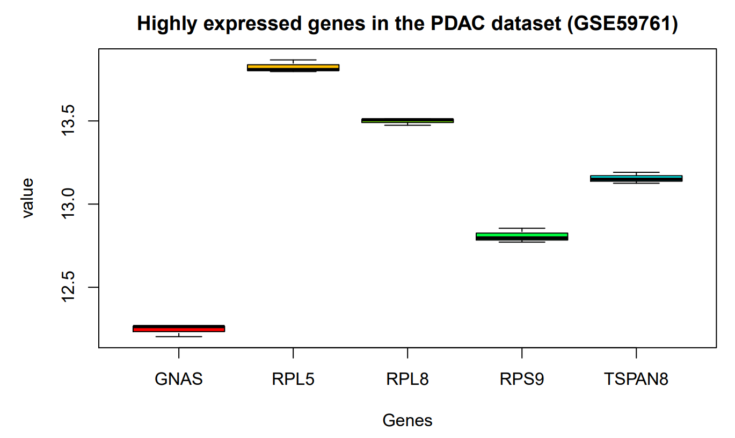
Highly expressed genes
Data Analysis; Anna Boot, Carolyn Blümcke, Selina Ernst, Bianca Greul; Supervisor: Dr. Dinkelacker

Slide 15
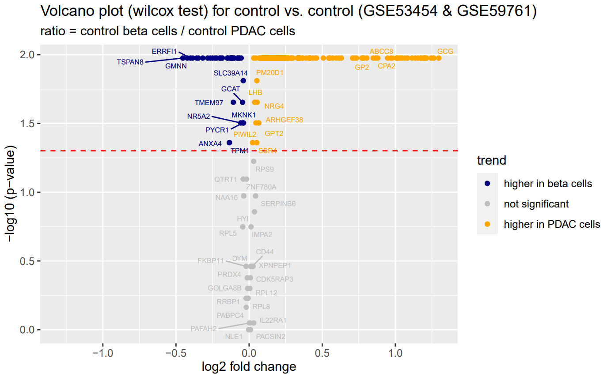
Volcano Plot Control vs. Control
Data Analysis; Anna Boot, Carolyn Blümcke, Selina Ernst, Bianca Greul; Supervisor: Dr. Dinkelacker

Slide 16
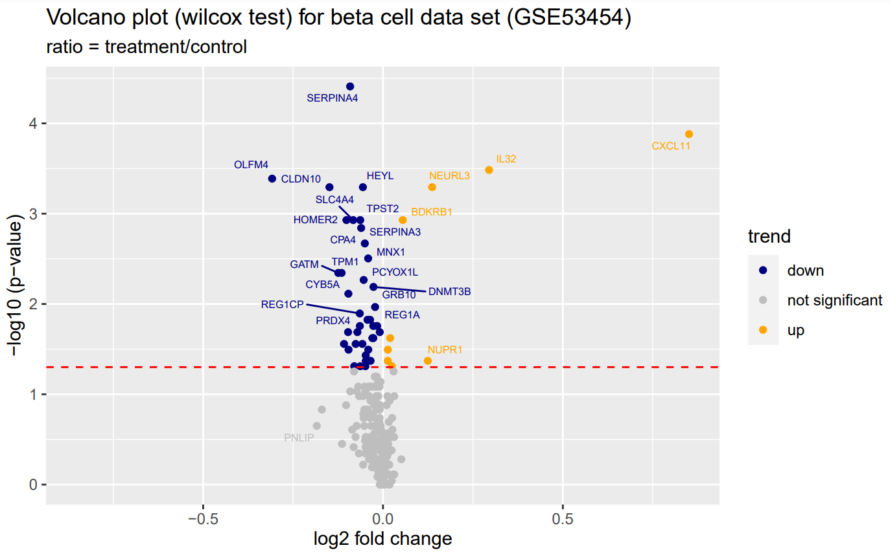
Volcano Plot Diabetes
Data Analysis; Anna Boot, Carolyn Blümcke, Selina Ernst, Bianca Greul; Supervisor: Dr. Dinkelacker

Slide 17
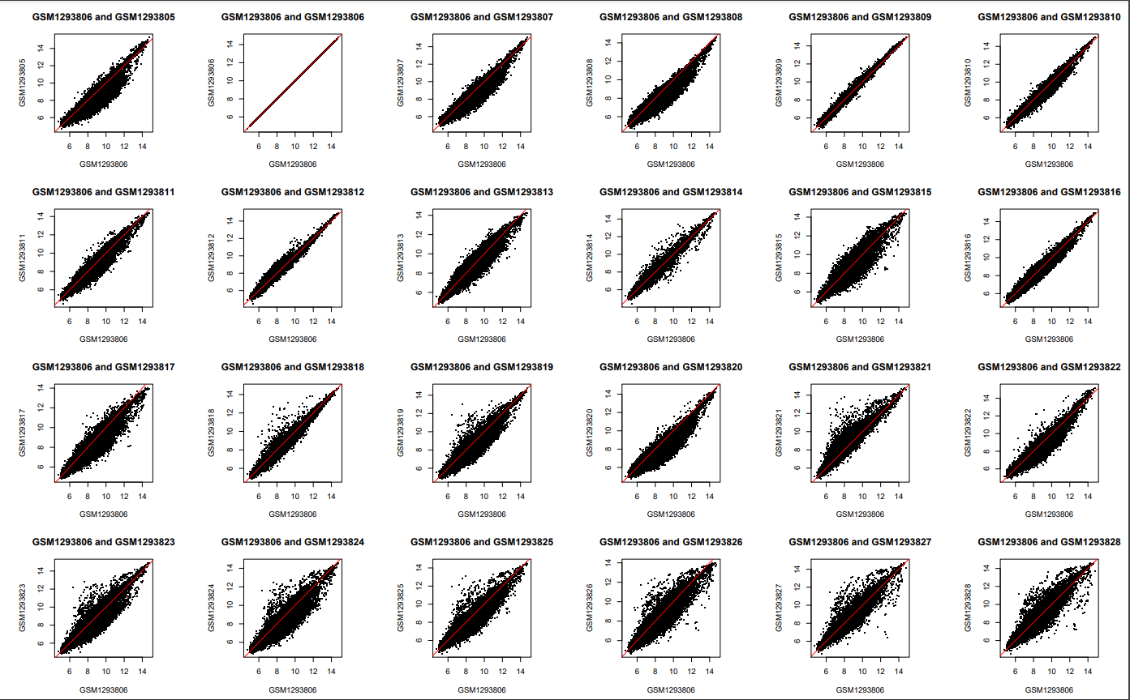
Data Analysis; Anna Boot, Carolyn Blümcke, Selina Ernst, Bianca Greul; Supervisor: Dr. Dinkelacker

Slide 18
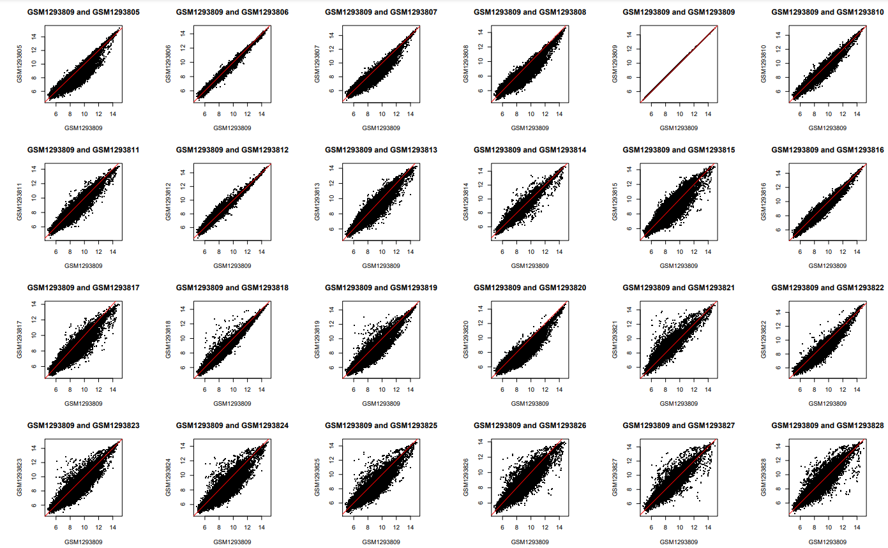
Data Analysis; Anna Boot, Carolyn Blümcke, Selina Ernst, Bianca Greul; Supervisor: Dr. Dinkelacker

Slide 19
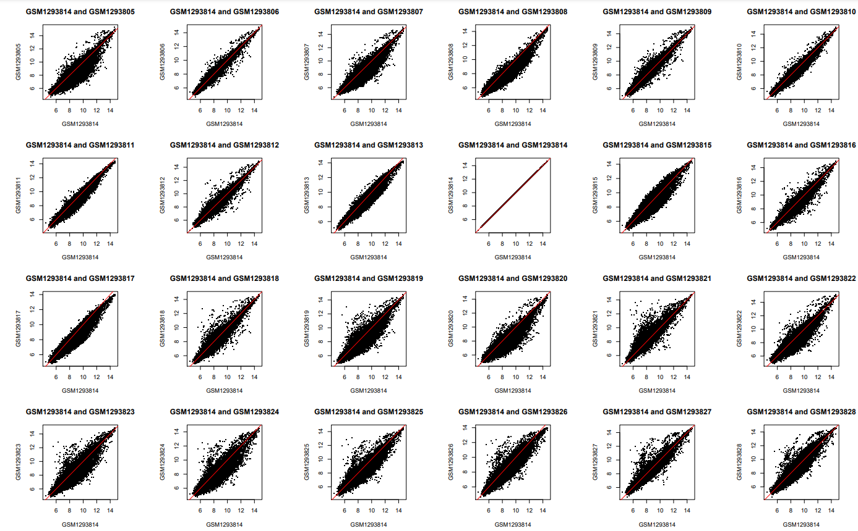
Data Analysis; Anna Boot, Carolyn Blümcke, Selina Ernst, Bianca Greul; Supervisor: Dr. Dinkelacker

Slide 20
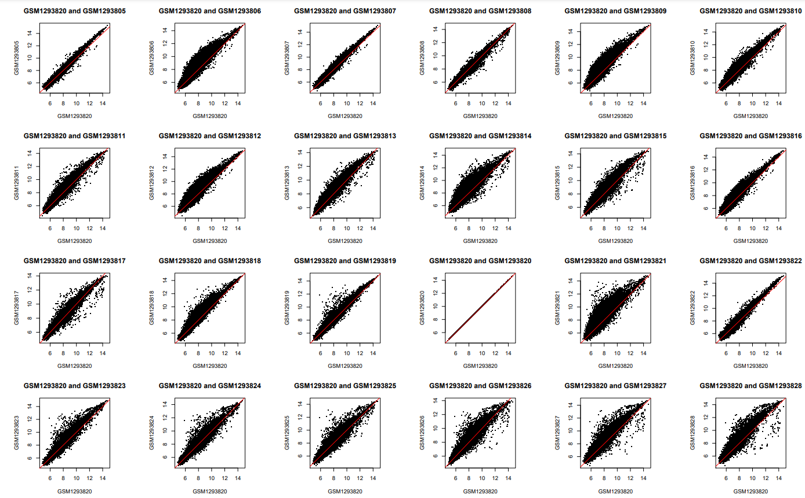
Data Analysis; Anna Boot, Carolyn Blümcke, Selina Ernst, Bianca Greul; Supervisor: Dr. Dinkelacker

Slide 21
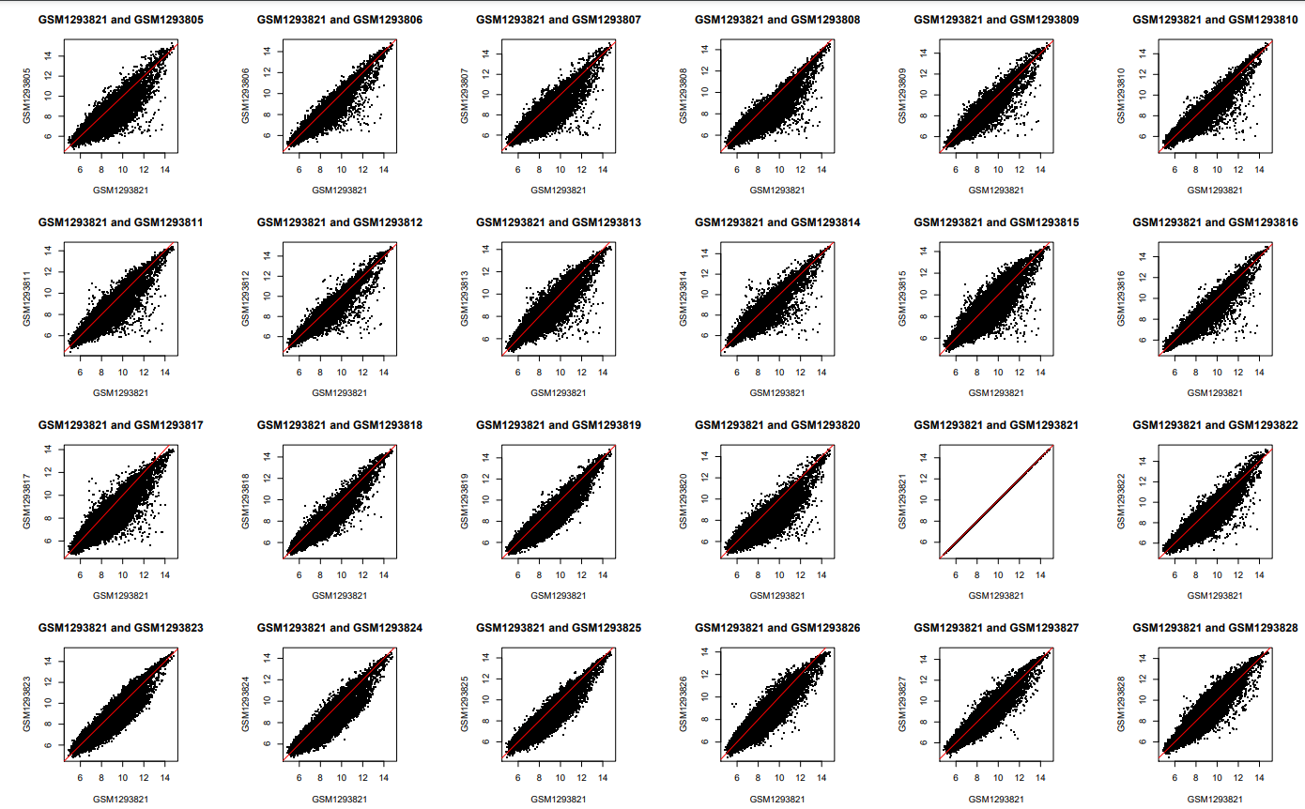
Data Analysis; Anna Boot, Carolyn Blümcke, Selina Ernst, Bianca Greul; Supervisor: Dr. Dinkelacker

Slide 22
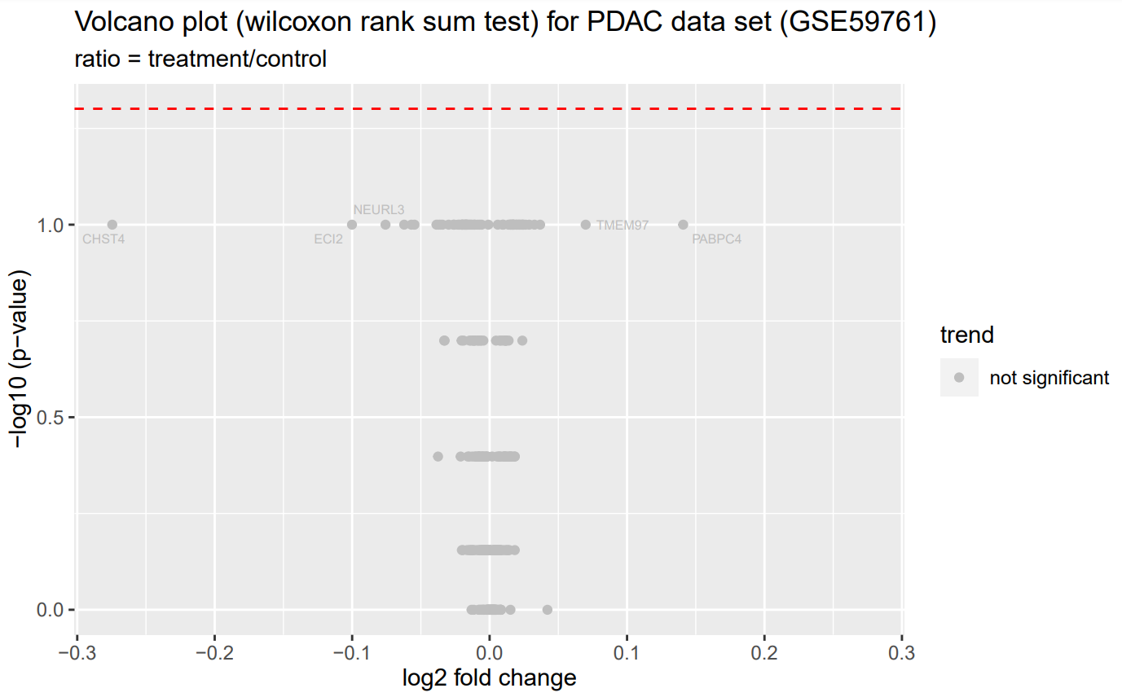
Volcano Plot PDAC
Data Analysis; Anna Boot, Carolyn Blümcke, Selina Ernst, Bianca Greul; Supervisor: Dr. Dinkelacker

Slide 23
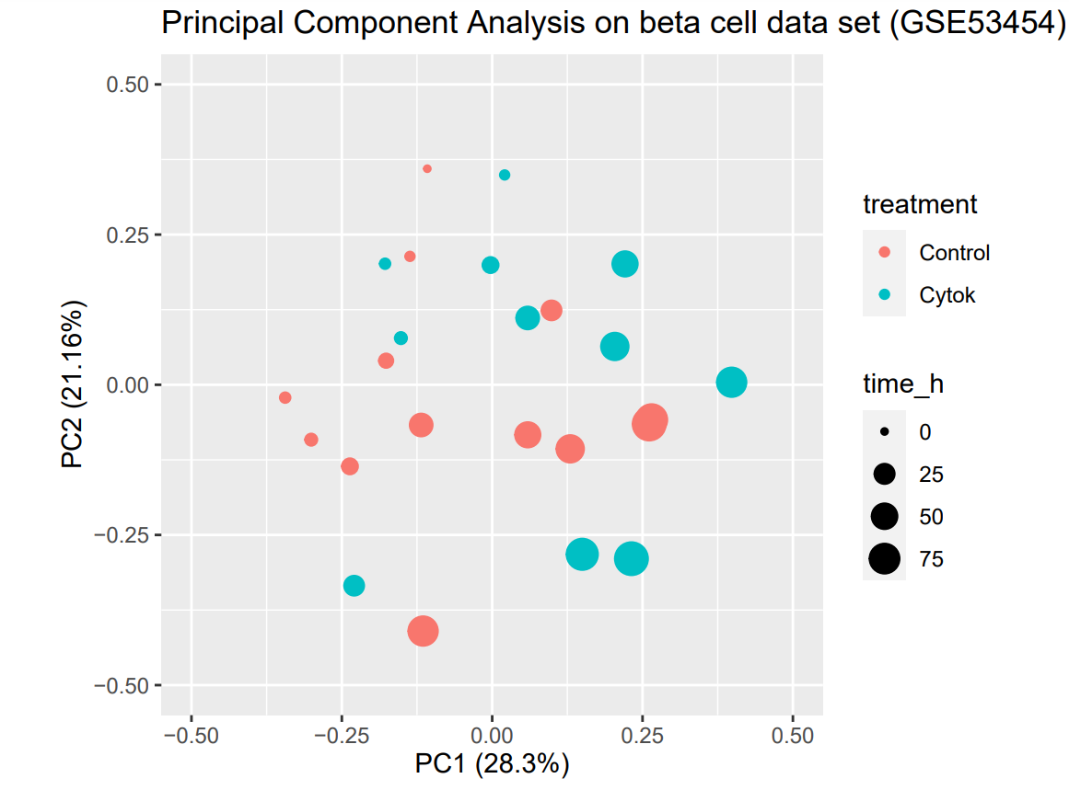
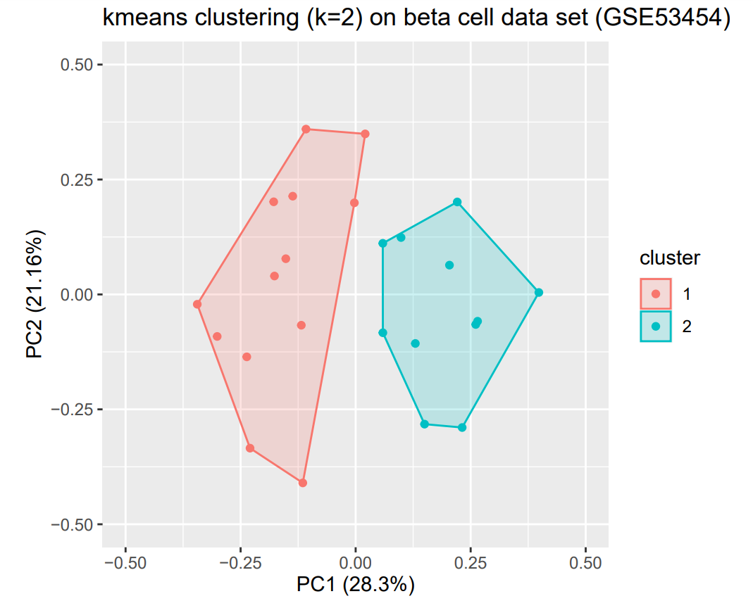
PDAC + kmeans Diabetes
Data Analysis; Anna Boot, Carolyn Blümcke, Selina Ernst, Bianca Greul; Supervisor: Dr. Dinkelacker

